Slide 1


Day 1 Introduction To Flutter
Marlon i. tayag

Slide 2
Flutter
Flutter is not a language (like JavaScript, for example). Flutter uses Dart for its language.
Flutter is Google’s mobile SDK / UI framework that enables developers to build native apps that run on Android and iOS devices. Developers write code in a single codebase that works on both platforms.
Notes:
This makes the code reusable. Moreover, functions Functions allow a program to be broken down into callable units. A callable unit is a portion of code that can
be executed via an identifier (or “called”) from another, not necessarily related, part of a program. For example, you
may have a function that causes the computer to beep, logically called beep(). You may want the computer to beep
both when the user hits the wrong key and when the user has a new e-mail message. You can call the same beep()
function from both places. This saves you having to write the logic for doing the beep twice. It also keeps your code
well-organized.make it easy to read and maintain the program’s code.

Slide 3
Benefits of Using Flutter Apps Dev
High Productivity
Flutter was written for high productivity, to get apps out fast.
You can change your code and hot reload the changes,without any kind of delay.
Flutter includes the UI Widgets you need.
Flutter works with most IDEs.

Slide 4
Benefits of Using Flutter Apps Dev
High Quality
The included Flutter UI Widgets work seamlessly and conventionally with the target platform. Scrolling, navigation, icons and fonts match the target system.
When you write an Android app with the Flutter
Widgets it looks like a normal Android app.
When you write an iOS app with the Flutter Widgets, it looks like a normal iOS app..

Slide 5
Benefits of Using Flutter Apps Dev
High Performance
The code you write in Flutter runs natively so it flies!
It is Free and Open
Flutter is free and Open Source.

Slide 6

Fuschsia
Fuschsia is Google’s next Operating System for mobile devices. All of the apps for Fuschsia are being developed by Google in Flutter.

Slide 7
Software For App Dev
VS Studio
Flutter SDK
Dart Platform
Xcode Runtime
Android Emulator and iOS Emulator

Slide 8
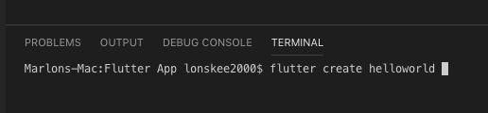
Creating First App
Open VS Studio
Create a Folder on Documents -> Flutter App
Drag Flutter App inside VS Studio to Add Folder
Right-clicked Flutter App folder inside VS Studio and select Open in Terminal
Inside the terminal type flutter create helloworld

Slide 9
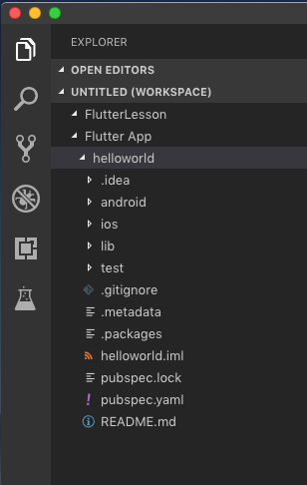
helloworld app with default application folders

Slide 10
Folders
The default Flutter application is organized into several folders
Folder | Description
[root] | Root folder. This usually contains configuration files. The most important of these configuration files is the ‘pubspec.yaml’ file, which declares the project dependencies.
.idea | Intellij project folder. Feel free to remove this folder if you are using Visual Studio Code.
android | As the name suggests, the folder contains all the Android-related files and code(s) for the application. This is where Android-specific settings and code resides. When building for Android, Flutter uses Gradle as the dependency manager.

Slide 11
Folders
The default Flutter application is organized into several folders
Folder | Description
build | This folder is created and used by gradle when you build the project.
ios | Similar to the ‘android’ folder, this folder contains the iOS related files and code(s) for the application.
lib | This is where the application code resides. You should see a file ‘main.dart’, the entry point for the Flutter application. This is the file you select and run. You will add more files and subfolders into this folder.

Slide 12
Folders
The default Flutter application is organized into several folders
Folder | Description
test | This is where the unit testing code resides. You may add more files and subfolders into this folder.

Slide 13
Emulators
These are great for developers, enabling them to develop their code to run on multiple devices, see how they look on each device. Later on, you can use the real hardware for final pre-release testing.

Slide 14
Open Emulator / Simulator
iOS Emulator
Open –a Simulator.app
Android Emulator
emulator –avd {AndroidVM}

Slide 15
Running the App
To run the flutter app type
flutter run
Note: You must be inside the project folder of your app

Slide 16
Hot Restarting & Reloading
Hot Restarting
This loads your changed code into the Dart VM and restarts the application. This is the safest thing to do and doesn’t take long.
Hot Reloading
If you want to load your changed code into the Dart VM but you don’t want to change the application state, you can do this. The result might be different behavior vs a hot restart.
If you are using ‘flutter’ run to run the app from the command line, you can use the key ‘R’ to hot restart and the key ‘r’ to hot reload.

Slide 17
Dependencies & Packages
The Dart ecosystem uses packages to manage shared software such as libraries and tools. To get Dart packages, you use the pub package manager. You can find publicly available packages on the Pub site, or you can load packages from the local file system or elsewhere, such as Git repositories. Wherever your packages come from, pub manages version dependencies, helping you get package versions that work with each other and with your SDK version.
Notes:
In Dart, you don’t have to develop everything from
scratch. There is a packaging system where developers
can develop packages and publish them. Other people can
then use these packages

Slide 18
Non-Core Packages
Flutter comes with many packages by default. These are called Core Packages and you don’t need to declare any kind of external dependency to use them

Slide 19
Flutter Boilerplate Code

Slide 20
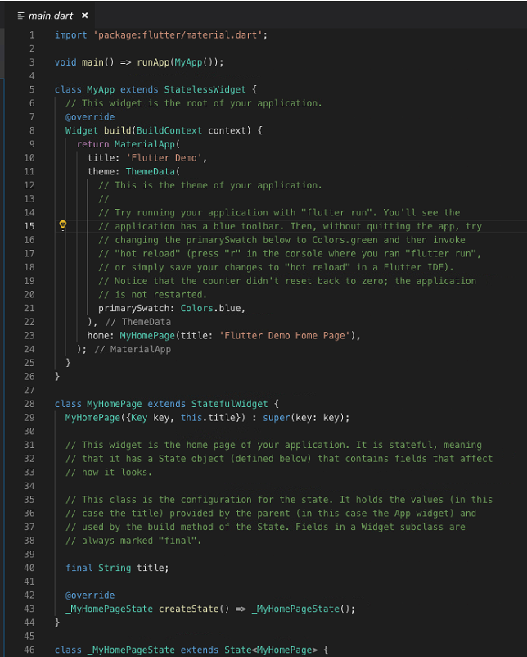

Slide 21
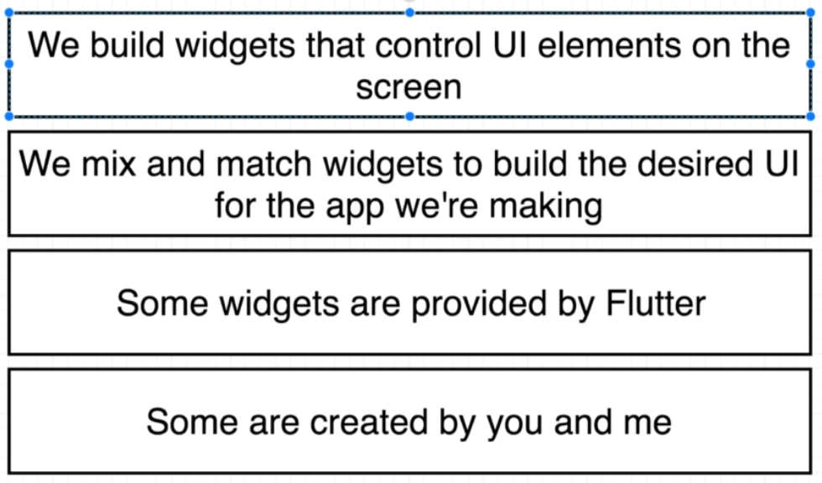
How do we make Flutter apps?

Slide 22
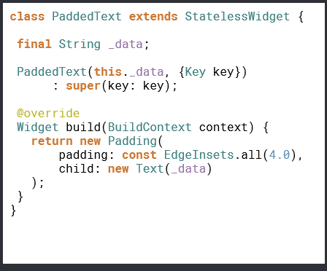
Widgets
Widgets are the Building Blocks of your UI. Whenever we build a user interface in Flutter, it is composed of Widgets. Putting your widgets together is called Composition. Think of a user interface as a jigsaw. Each widget is a piece of the puzzle:

Slide 23
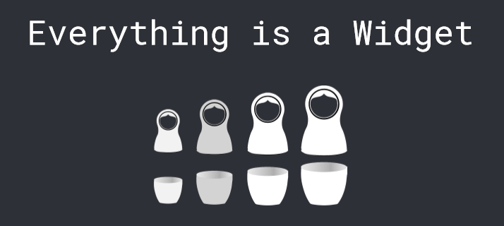

Slide 24
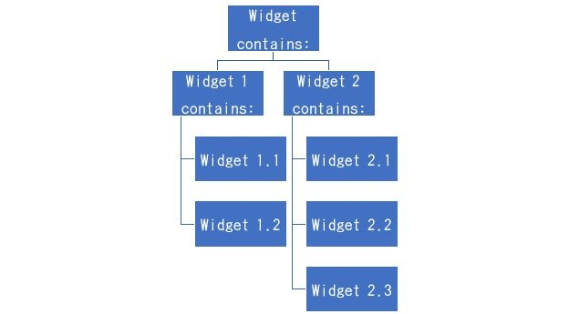
Widget Tree
Unlike a Jigsaw, a widget can contain other widgets, in a tree structure, a hierarchy. This is often called a Widget Tree.

Slide 25
Everything is a Widget
App Widget
Material Widget
Scaffold Widget
Text
Column
Render Tree
Button
Container
Notes:
Every thig is a widget , we mean everyting you coffe cup , , your keyboard is a widget, your dog

Slide 26
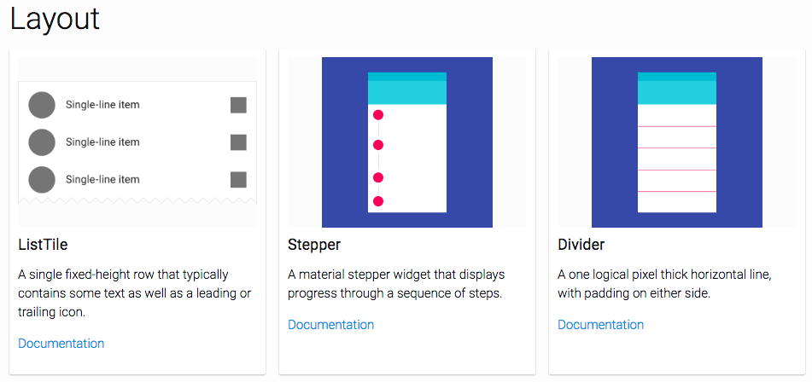
https://flutter.io/widgets/widgetindex/

Slide 27
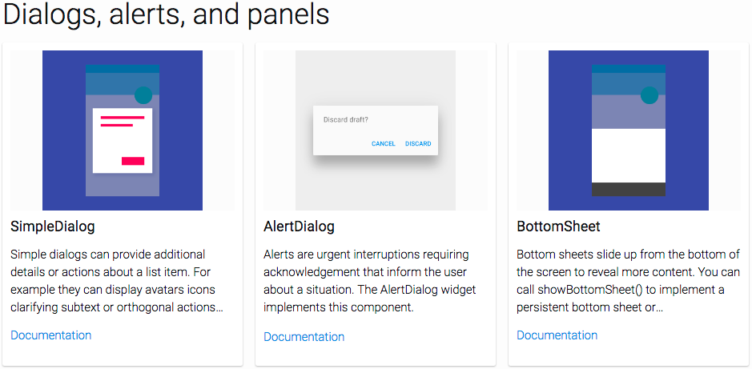
https://flutter.io/widgets/widgetindex/

Slide 28
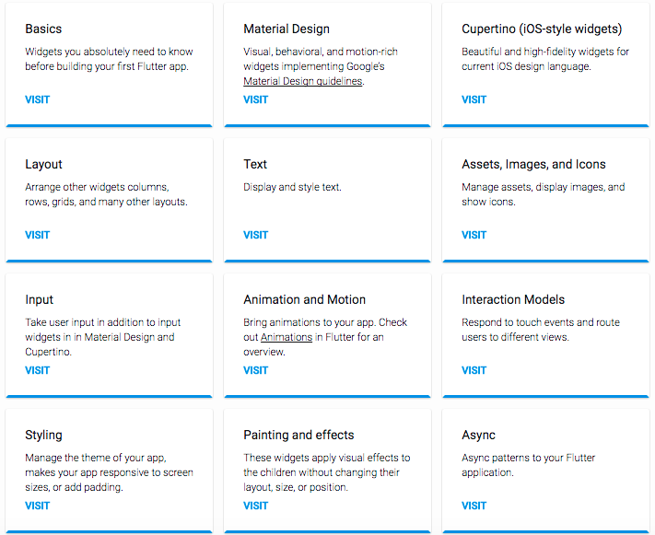
https://flutter.io/widgets/

Slide 29
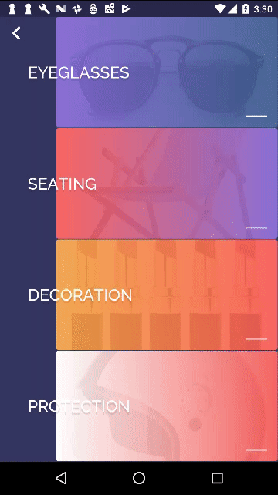
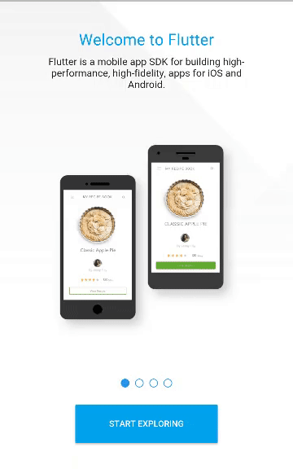
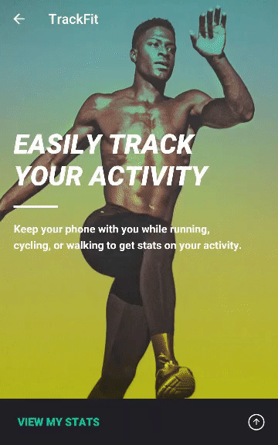
Great looking and fast Widgets

Slide 30
Creating the real HELLOWORLD app

Slide 31
Coding Steps helloword app
Delete all template code
Import library (widget.dart)
Create main()
Implement widgets
Center
Text
TextStyle
Use runApp() to load app

Slide 32
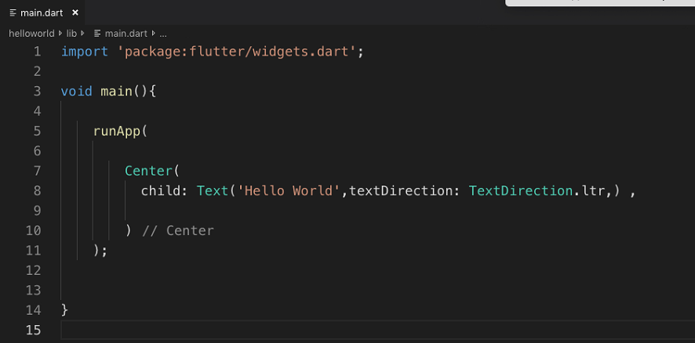

Slide 33
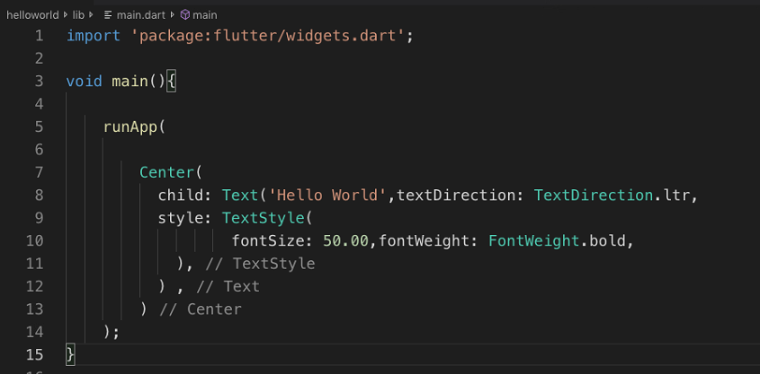
Using TextStyle (helloworld)

Slide 34
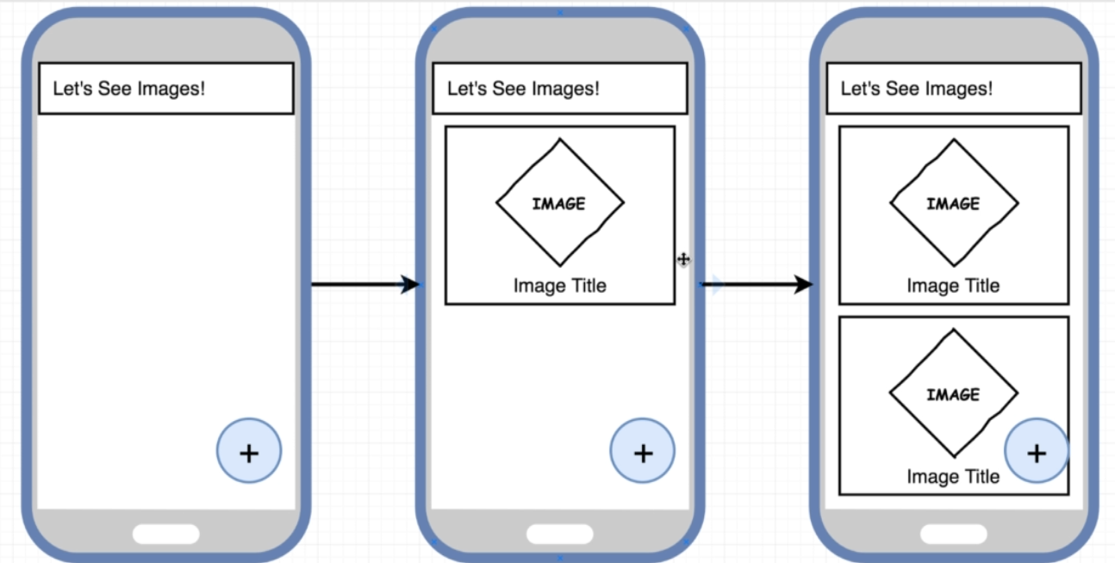
Target App
Welcome to FlutterDev
1

Slide 35
Four step design process
Import helper library from flutter to get content on the screen
Define a ‘main’ function to run when our apps starts
Create a new text widget to show some text on the screen
Take the widget and get it on the screen

Slide 36
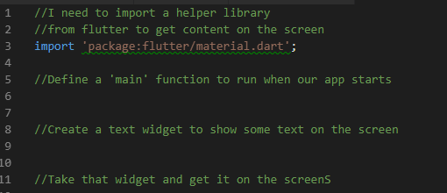
Import Statements

Slide 37
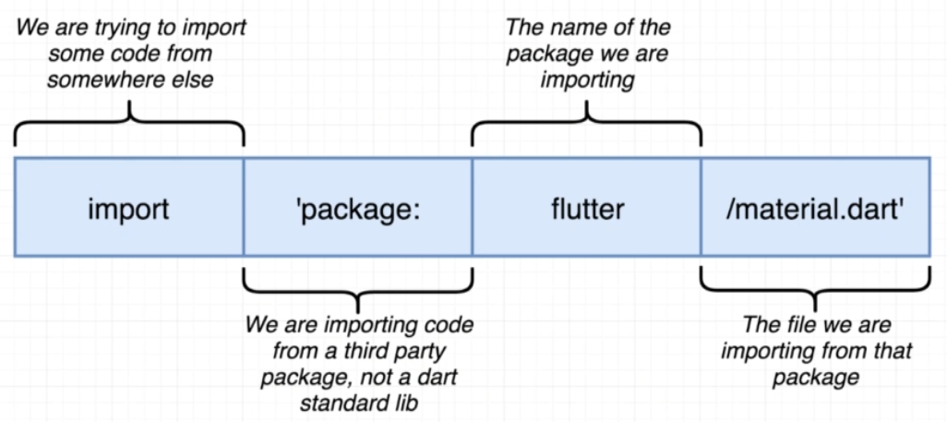
Import Statements

Slide 38
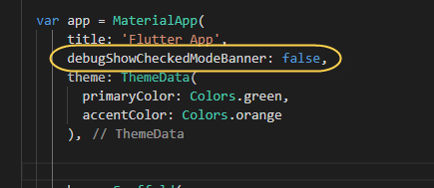
To remove Debug Banner on App
Add debugShowCheckedModeBanner: false,

Slide 39
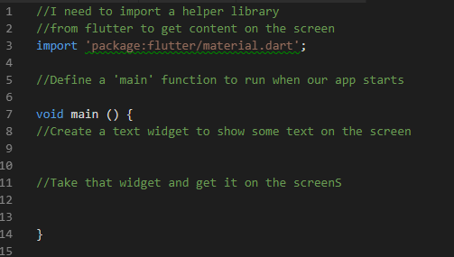
Creating Main Function
Notes:
Steps 3 and 4 will done inside the main function

Slide 40
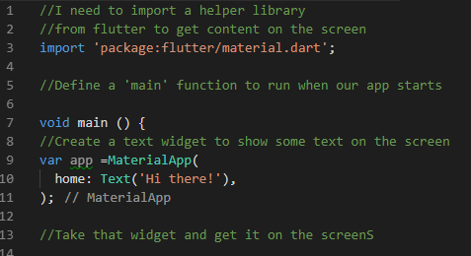
Creating A Widgets

Slide 41
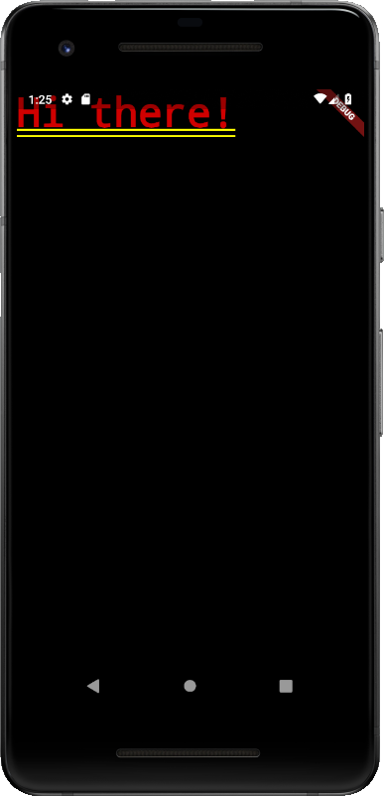
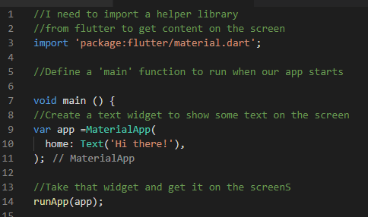
Show the Widget on the Screen

Slide 42
Run the App
Go to terminal type flutter run
To hot reload press Shift+R

Slide 43
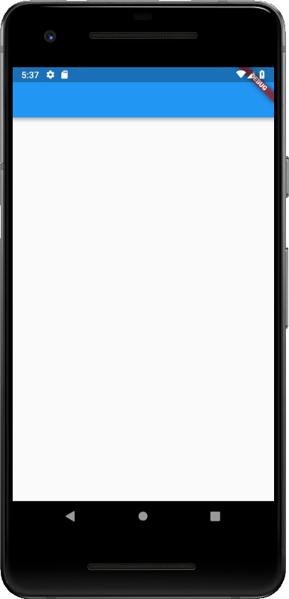
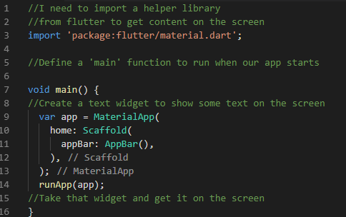
Using Scaffold Class

Slide 44
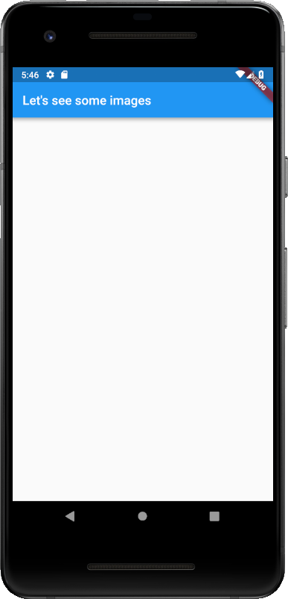
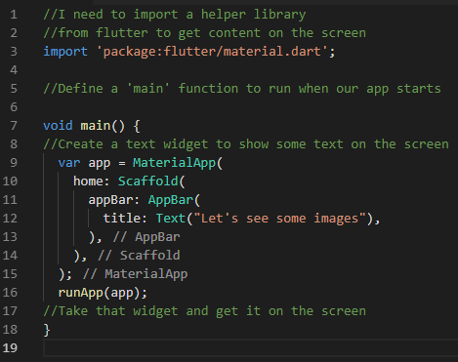
Customizing AppBar

Slide 45
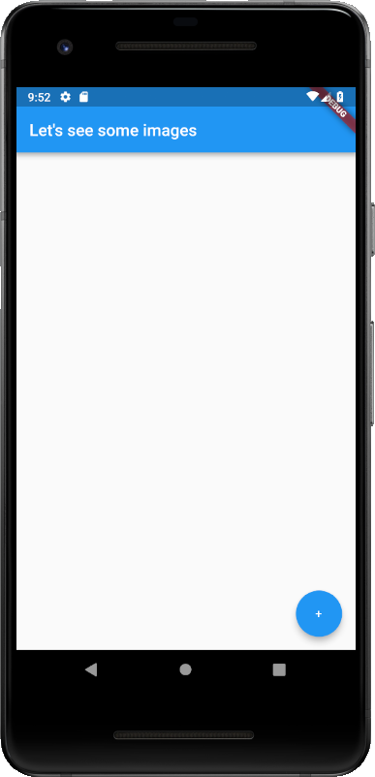
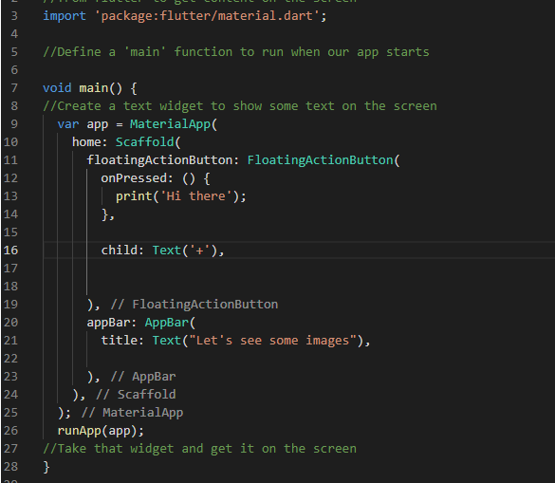
Adding FloatingActionButton (Text)

Slide 46
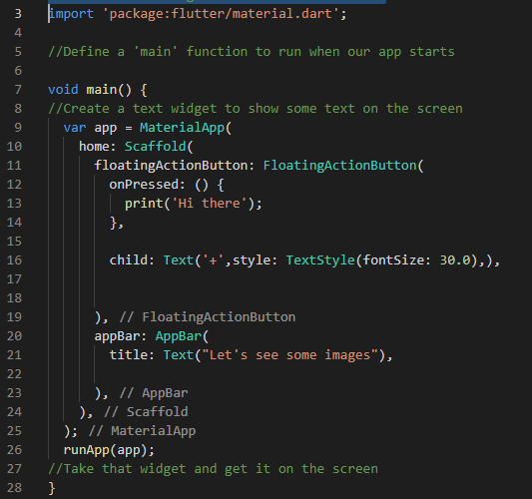

Adding FloatingActionButton (TextStyle)

Slide 47
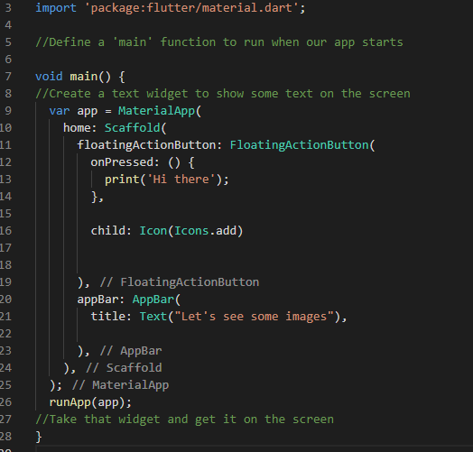

Adding FloatingActionButton (Icon)

Slide 48
Activity: Change Icon Property
Change the icon background to black
Change the icon color to white

Slide 49
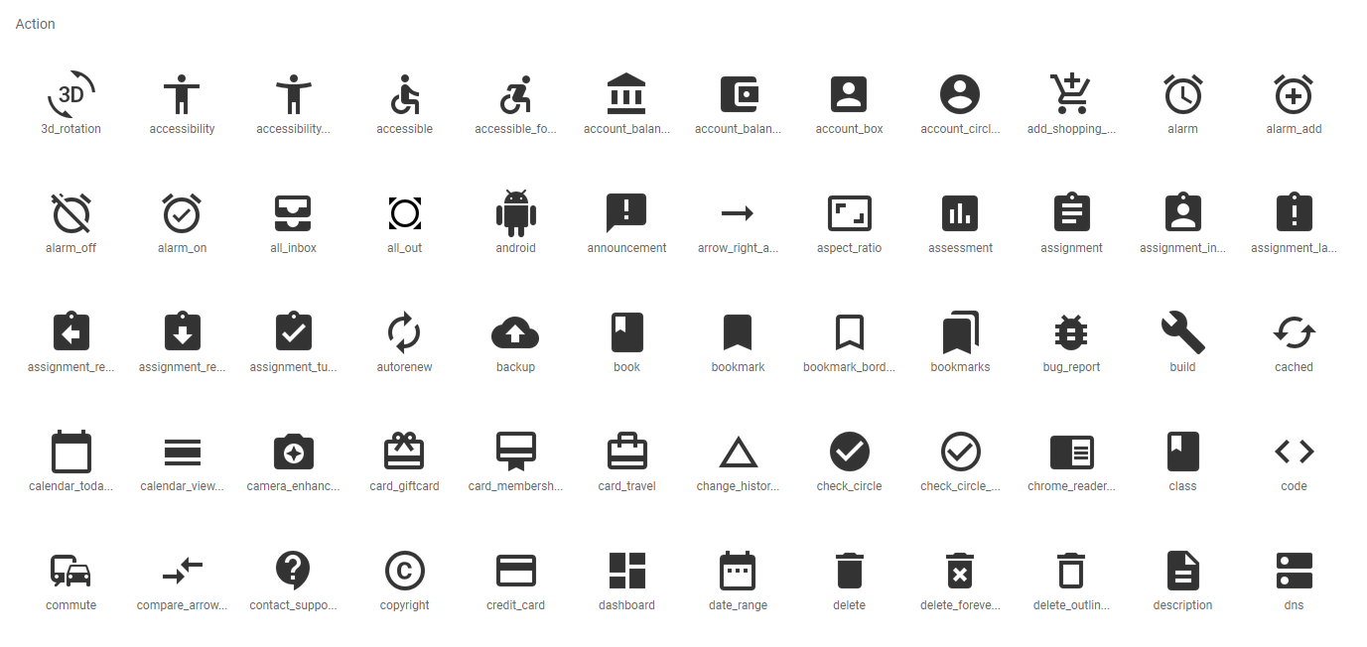
Icon Material Design
https://material.io/tools/icons

Slide 50
Creating Custom Widget and Working With Stateless Widget

Slide 51
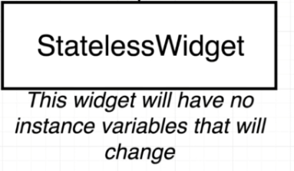

Slide 52
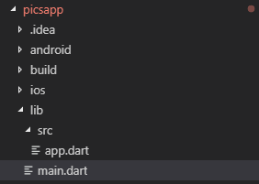
Creating Custom Widget
1. Create a new folder src
2. Create a new file app.dart

Slide 53
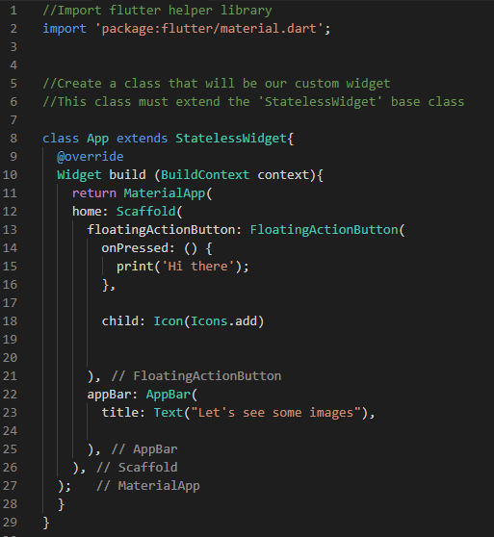
Creating Custom Widget (app.dart)
1. Import flutter library
2. Create a extended StatelessWidget
3. Copy code from main.dart

Slide 54
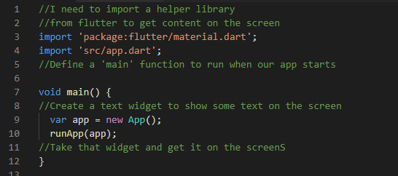
Creating Custom Widget (main.dart)
1. Import app.dart using relative PATH
1. Declare and use class App()

Slide 55
Widget Tree
App
Material App
FloatingActionButton
AppBar
Icon
Text

Slide 56
Increment every time + is click
Welcome to FlutterDev
1

Slide 57
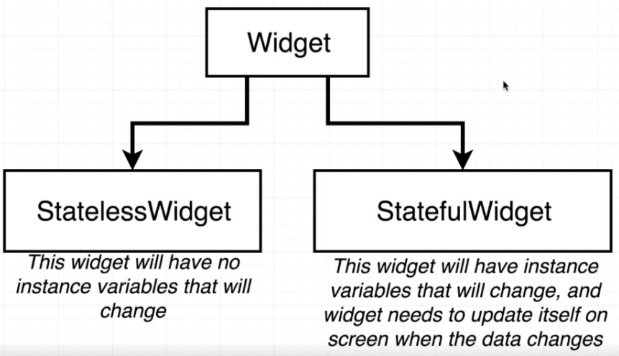
Refactor StatelessWidget to StatefulWidget

Slide 58
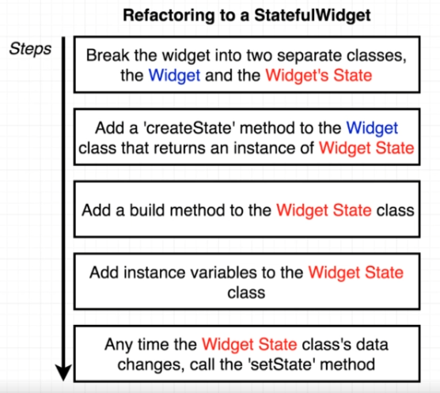
Refactor StatelessWidget to StatefulWidget

Slide 59
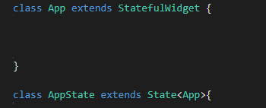
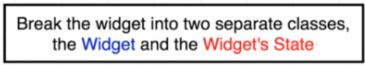
Refactor StatelessWidget to StatefulWidget

Slide 60
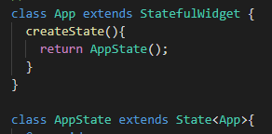
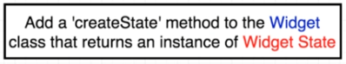
Refactor StatelessWidget to StatefulWidget

Slide 61
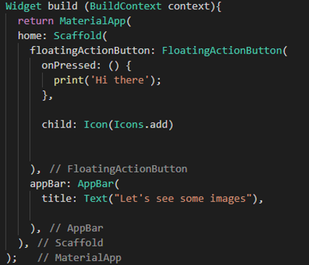
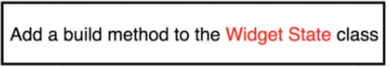
Refactor StatelessWidget to StatefulWidget

Slide 62
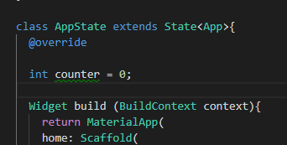
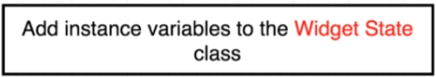
Refactor StatelessWidget to StatefulWidget

Slide 63
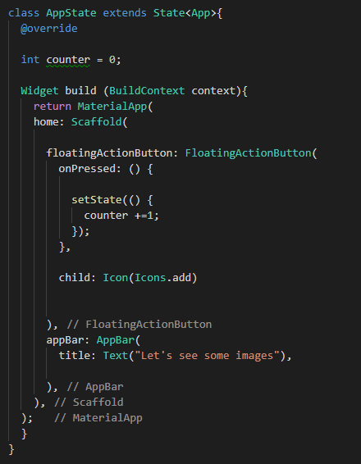
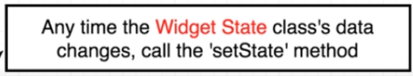
Refactor StatelessWidget to StatefulWidget
Show the value on the screen

Slide 64
Align Text Using Container

Slide 65
Activity: Change Color (Blue and Red)
Change the color of the item RED the value of the item is greater than 10

Slide 66
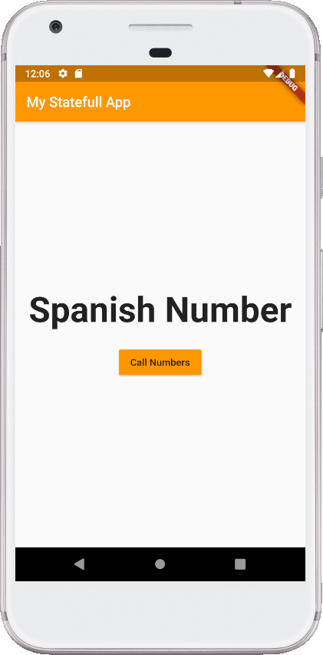
Spanish Number App (Working With Stateful Widget)
Create an app that randomly show a number in Spanish
Widget to used:
Stateful Widget
MaterialApp
RaiseButton
Scaffold
AppBar
Text

Slide 67
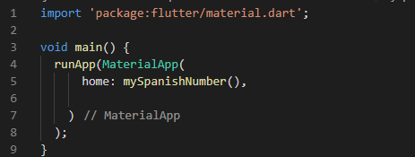
1. Import Library and create Main()

Slide 68


2.Create the Stateful Widgets
mySpanishNumber
mySpanishNumberState (1)

Slide 69

mySpanishNumberState (2)

Slide 70

mySpanishNumberState (3)

Slide 71
Spanish Number Code (main.dart)

